Slide 1
Solving simple linear equations with a multiplicative step
Solving linear equations

Slide 2
how to use Oak lessons

Slide 3
I can solve a linear equation requiring a single multiplicative step.

Slide 4
The solution(s) to an equality is/are the value(s) which, when substituted, maintain(s) the equality between the expressions.
The process of finding a solution to an equation is called solving.
The reciprocal is the multiplicative inverse of any non-zero number. Any non-zero number multiplied by its reciprocal is equal to 1

Slide 5

Solving simple linear equations with a multiplicative step
Multiplicative steps using representations
Writing solutions algebraically

Slide 6
Multiplicative steps using representations
An equation with a multiplicative step can be represented with a bar model.
a
a
14
What equations can you write from this bar model?
a + a = 14
2a = 14
a = 14 − a
14 − a = a
Do any of these equations show us the solution?
2a = 14 might give us the most information, but none of these show us how to calculate the solution yet.

Slide 7
Multiplicative steps using representations
To find the solution we need to work out the value of one positive a
a
a
14
How could we isolate one a from this bar model?
We could split the bar in 2
a
a
7
7
What is the value of each half of the bottom bar?
So there is a solution when a is 7

Slide 8

Multiplicative steps using representations
What operation have we used to isolate one a ?
a
a
a
a
14
7
7
Divided by 2
Halved. Or multiplied by a half.
Dividing by 2 and multiplying by are the same operation.
In this bar model, either one will isolate one positive a
The solution is when a is 7

Slide 9
Multiplicative steps using representations
We can check our answer by substituting into any of our equations.
a
a
a
a
a + a = 14
2a = 14
a = 14 − a
14 − a = a
14
7
7
(7) + (7) | = | 14
14 | = | 14
(7) | = | 14 − (7)
7 | = | 7
2(7) | = | 14
14 | = | 14
14 − (7) | = | (7)
7 | = | 7
So a = 7 is the correct solution for all these equations.

Slide 10
Multiplicative steps using representations
This bar model represents the equation 5s = 30 or 30 = 5s
30
s
s
s
s
s
It does not matter which bar the unknown is part of or which side of the equation the unknown is on.
This is a multiplicative relationship as 5 lots of s have the value of 30 or 5 × s = 30

Slide 11

Multiplicative steps using representations
30
6
6
6
6
6
s
s
s
s
s
s
s
s
s
s
To find the value of one positive s we can split the bar into 5 sections. What do we need to do to the value 30?
Divide 30 by 5
Find a fifth of 30
÷ 5 and are the same operation, either will find the value of s
The solution is when s is 6

Slide 12

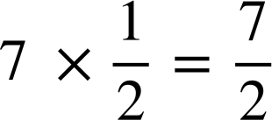
Multiplicative steps using representations
Unknowns can have values which are non-integer.
How could we find the value of a this time?
a
a
a
a
7
Divide by 2
7 ÷ 2 =
or
Find / multiply by
So the solution is when a is

Slide 13
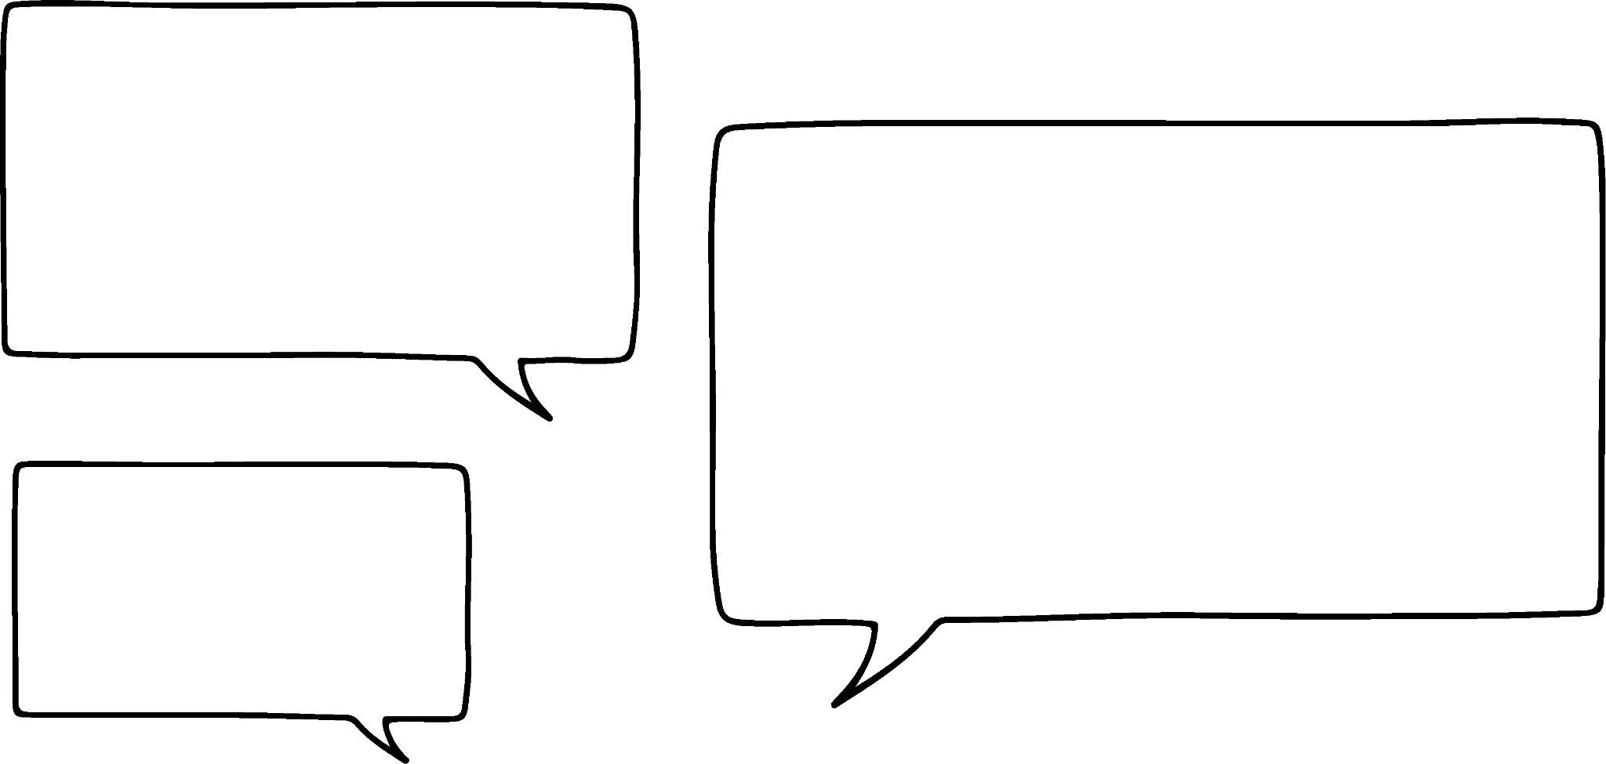


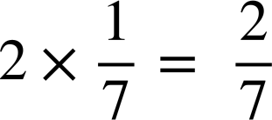

Multiplicative steps using representations
I want to solve the equation 7x = 2 will this have the same solution as the previous question?
x
x
x
x
x
x
x
2
x
x
x
x
x
x
x
Izzy
We need to find of 2
So the solution is when x is
This is different to the equation 2x = 7 which had a solution of

Slide 14


Multiplicative steps using representations
Find the value of x for this bar model.
Find the value of x for this bar model.
x
x
x
x
x
x
x
x
x
x
x
x
x
x
24
6
6
6
6
27
9
9
9
24 × = 6
27 × = 9
Solution when x is 6
Solution when x is 9
We can check our answer.
(6) + (6) + (6) + (6) = 24
4(6) = 24
24 = 24
Check your answer by substitution.
(9) + (9) + (9) = 27
3(9) = 27
27 = 27

Slide 15

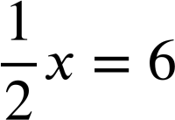
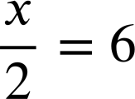
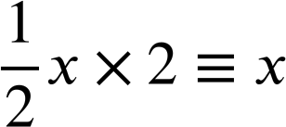
Multiplicative steps using representations
What equation is represented in this bar model?
x
6
12
What could we do to work out the value of one positive x ?
Double/ multiply by 2
6 × 2 = 12

Slide 16
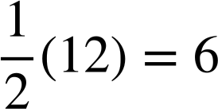
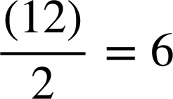
Multiplicative steps using representations
The solution to this equation is when x is 12
x
6
12
We can check our answers by substituting.
6 = 6
6 = 6

Slide 17

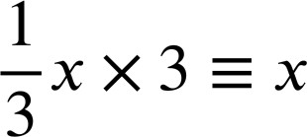
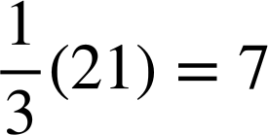
Multiplicative steps using representations
What could we do to work out the value of one positive x this time?
x
7
21
Multiply by 3
The solution to this equation is when x is 21
We can check by substituting
7 × 3 = 21
7 = 7

Slide 18

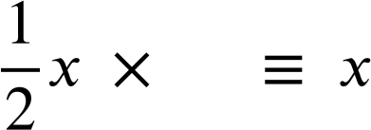


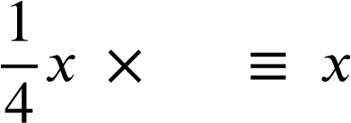
Multiplicative steps using representations
Complete these calculations so they are equivalent to x
a
2
b
c
d
4

Slide 19
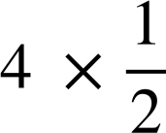
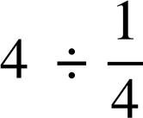

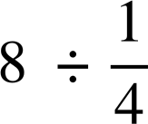
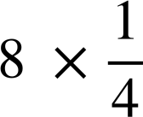
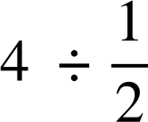

Multiplicative steps using representations
Match up the bar models with the calculations which will find the solution. There may be more than one calculation for each diagram.
a)
x
x
d)
4
4 ÷ 2
4 × 2
4
b)
x
x
x
x
8
e)
8
8 ÷ 4
c)
4
4 × 4
8 × 4

Slide 20

Multiplicative steps using representations
2) Use these bar models to find the value of x
a)
x
x
x
x
x
d)
x
x
x
15
5
b)
15
e)
18
x
x
x
x
x
x
x
c)
30
f)
x
x
x
x
x
x
x
x
x
x
10

Slide 21
Multiplicative steps using representations
Match up the bar models with the calculations which will find the solution. There may be more than one calculation for each diagram.
a)
x
x
d)
4
4 ÷ 2
4
4 × 4
b)
x
x
x
x
8
8 ÷ 4
e)
c)
8
4 × 2
8 × 4
4

Slide 22
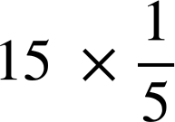
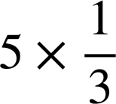
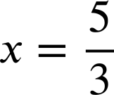
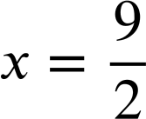
Multiplicative steps using representations
2) Use these bar models to find the value of x
a)
x
x
x
x
x
d)
x
x
x
15
x = 3
5
b)
15
15 ÷ 3
e)
18
18 ÷ 4
x
x
x
x = 5
x
x
x
x
c)
30
30 ÷ 10
f)
10 × 5
x
x
x
x
x
x
x
x
x
x
x = 3
10
x = 50

Slide 23
Solving simple linear equations with a multiplicative step
Multiplicative steps using representations
Writing solutions algebraically

Slide 24

Writing solutions algebraically
We can use the same method for equations without representations.
Solve the equation 7x = 42
7x | = | 42
To isolate one positive x, we need to multiply by the reciprocal of 7:
7x × ≡ x
7x × ( ) | = | 42 × ( )
x | = | 6
We have written our working down the page and maintained equality by multiplying both sides of the equation by the same value.
We have found an equivalent equation where the solution is obvious.

Slide 25

Writing solutions algebraically
Solve the equation 7x = 42
7x ÷ 7 ≡ x, so I could divide both sides of the equation by 7 to solve.
Is Sofia correct?
Sofia
Yes, to solve this equation we could multiply by or divide by 7
7x | = | 42
7x ÷ (7) | = | 42 ÷ (7)
x | = | 6
7x | = | 42
7x ÷ (7) | = | 42 ÷ (7)
7x | = | 42

Slide 26
Writing solutions algebraically
7x = 42
The solution to this equation is when x is 6
We can check our answer by substituting the solution into the original. equation.
7x = 42
7(6) = 42
42 = 42
Both sides of the equation balance when x is 6 so our solution must be correct.

Slide 27


Writing solutions algebraically
I want to solve the equation 5x = 7
I have the equation 7 = 5x to solve
Laura
Jacob
Should they get the same answer?
Yes, they are the same equation, it does not matter which side of the equals sign the unknown is on.
What do we need to do to isolate one positive x?
Multiply by the reciprocal of 5
÷ 5
Or divide by 5

Slide 28
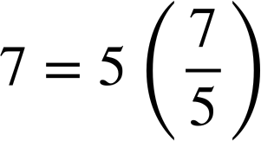

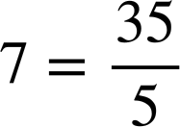


Writing solutions algebraically
Solve the equation 7 = 5x
Checking by substituting
7 | = | 5x
7 × ( ) | = | 5x × ( )
 | = | x
The solution is when x is

Slide 29


Writing solutions algebraically
Solve the equation 15x = −45
Solve the equation 4x = −28
15x | = | −45
4x | = | −28
4x × ( ) | = | −28 × ( )
4x | = | −28
15x × ( ) | = | −45 × ( )
x | = | −3
x | = | −7
We can check our answer:
Check your answer by substituting.
15(−3) | = | −45
−45 | = | −45
15(−3) | = | −45
4(−7) | = | −28
−28 | = | −28
4(−7) | = | −28

Slide 30
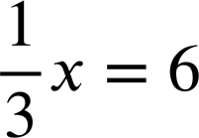
Writing solutions algebraically
We can solve equations where the coefficient of the variable is a fraction.
Solve the equation
The reciprocal of is 3 .
To isolate one positive x, we can multiply this equation by 3
 | = | 6
× (3) | = | 6 × (3)
x | = | 18

Slide 31
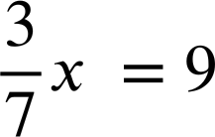



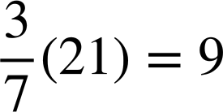
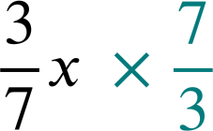
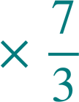

Writing solutions algebraically
How could we solve the equation ?
What do we need to multiply by to get 1?
The reciprocal, which is
Checking by substituting
 | = | 9
 | = | 9
9 = 9
x | =
x | = | 21

Slide 32
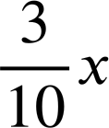
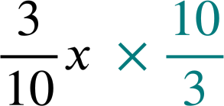
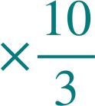

Writing solutions algebraically
Solve 0.3x = 6
I’m not sure what the reciprocal of 0.3 is…
What could Sofia do?
or
Sofia
She could convert 0.3 into a fraction
0.3x ÷ 0.3 ≡ x so she could divide both sides of the equation by 0.3
 | = | 6
0.3x | = | 6
 | = | 6
0.3x ÷ 0.3 | = | 6 ÷ 0.3
x | =
x | = | 60 ÷ 3
x | = | 20
x | = | 20

Slide 33
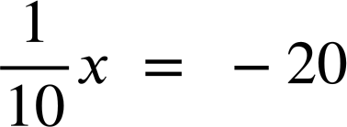
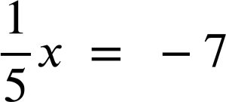

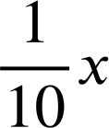
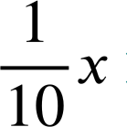
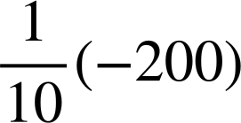
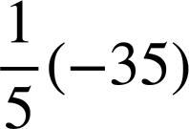
Writing solutions algebraically
Solve the equation
Solve the equation
 | = | −7
 | = | −20
× 5 | = | −7 × 5
× 10 | = | −20 × 10
x | = | −200
x | = | −35
We can check our answer:
Check your answer by substituting.
 | = | −20
 | = | −7
−20 | = | −20
−7 | = | −7

Slide 34
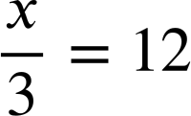

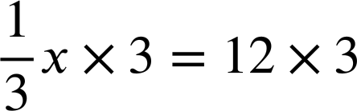

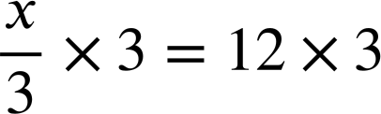

Writing solutions algebraically
Lucas and Jacob are solving the equation
Here is my work.
I think x = 36
I don’t need to show my working out, it’s easy.
3 × 4 is 12 so x = 4
Lucas is correct.
Jacob has made a common mistake in thinking he needs to divide 12 by 3
Lucas
Who do you think is correct?
Jacob

Slide 35

Writing solutions algebraically
When solving equations like this
Lucas’s work:
You can read it as x divided by 3 and remember that the inverse operation would be to multiply by 3, and do this to both sides of the equation.
Or you can read it as of x so you multiply by the reciprocal of which is or just 3, like Lucas did.
Both of these are different ways of saying the same thing.

Slide 36
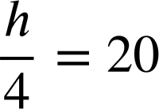
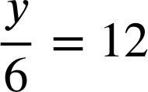
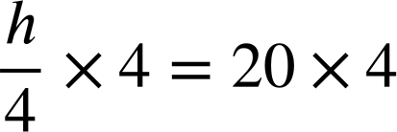
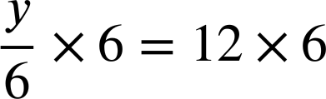


Writing solutions algebraically
Solve the equation
Solve the equation

Slide 37

Writing solutions algebraically
We can also solve equations with negative x by using a multiplicative step.
What can you multiply −x by to make positive x ?
 | =
× (−1) or you could ÷ (−1)
What do I need to do to the right hand side to maintain equality?
−3 × (−1) or −3 ÷ (−1)
When using physical algebra tiles, you can flip all of the tiles over to multiply by −1

Slide 38





Writing solutions algebraically
3 pupils are solving the equation −5x = 35. Which method do you think is best?
−5x | = | 35
−5x × (−1) | = | 35 × (−1)
5x | = | −35
5x × ( ) | = | −35 × ( )
x | = | −7
−5x | = | 35
−5x ÷ (−1) | = | 35 ÷ (−1)
5x | = | −35
5x ÷ (5) | = | −35 ÷ (5)
x | = | −7
−5x | = | 35
−5x × ( ) | = | 35 × ( )
x | = | −7
I have multiplied by −1 then multiplied by
I have divided by −1 then by 5
I have multiplied by
Andeep
Jun
Laura

Slide 39
Writing solutions algebraically
Three pupils are solving the equation −5x = 35
Which method do you think is best?
−5x | = | 35
−5x × (−1) | = | 35 × (−1)
5x | = | −5
5x × ( ) | = | −5 × ( )
x | = | −1
−5x | = | 35
−5x ÷ (−1) | = | 35 ÷ (−1)
5x | = | −5
5x ÷ (5) | = | −5 ÷ (5)
x | = | −1
−5x | = | 35
−5x × ( ) | = | 35 × ( )
5x | = | −5
All 3 methods work perfectly so it is down to personal preference. Andeep and Jun have solved in 2 steps and Laura in 1 step. The pupils could also have divided both sides by −5 to solve the equation in one step.

Slide 40
Writing solutions algebraically
Izzy has tried to solve the equation −8x = −56
What has she done well?
Where has she made a mistake?
What is the correct solution?
The solution is when x is −7
−8x | = | −56
−8x ÷ (8) | = | −56 ÷ (8)
−x | = | −7
Izzy
E.g. she has maintained equality by dividing both sides by 8.
E.g. All her working is correct but she hasn’t found the solution yet, she needs the value of 1 positive x
Multiply both sides by −1, so the solution is when x is 7

Slide 41



Writing solutions algebraically
Solve each equation.
2x | = | 18
21x | = | −21
 | = | 13
a)
d)
g)
b)
e)
h)
6x | = | 30
−2x | = | −12
 | = | −10
5x | = | 9
c)
f)
i)
−8x | = | 18
 | = | 42

Slide 42
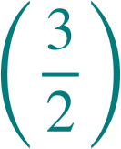



Writing solutions algebraically
Solve each equation.
 | = | 13
× (4) | = | 13 × (4)
x | = | 52
g)
2x | = | 18
2x ÷ (2) | = | 18 ÷ (2)
x | = | 9
21x | = | −21
21x ÷ (21) | = | −21 ÷ (21)
x | = | −1
a)
d)
 | = | −10
× | = | −10 ×
x | = | −15
h)
b)
e)
6x | = | 30
6x ÷ (6) | = | 30 ÷ (6)
x | = | 5
−2x | = | −12
−2x ÷ (−2) | = | −12 ÷ (−2)
x | = | 6
i)
−1.4x | = | 4.2
−1.4x ÷ (1.4) | = | 4.2 ÷ (1.4)
−x | = | 42 ÷ (14)
−x | = | 3
x | = | −3
5x | = | 9
5x …. | = | 9
x | =
c)
f)
−8x | = | 18
−8x ÷ (−8) | = | 18 ÷ (−8)
x | =

Slide 43
Solving simple linear equations with a multiplicative step
Equations with a multiplicative step can be represented in a bar model.
The solution can be found by considering how to isolate a single positive unknown.
Equations with a multiplicative step can be solved by multiplying both sides of the equation by the reciprocal of the coefficient of the unknown.
When coefficients are negative it is important to multiply by a negative value to isolate the single positive unknown.

Slide 44

© Oak National Academy 2023.
Produced in partnership with Mathematics in Education and Industry.
Licensed on the Open Government Licence v3.0, except where otherwise stated. See Oak terms and conditions.

